Slide 1
Unit 4: Introduction to 8086 Microprocessor
Introduction to 8086 microprocessor, Real mode & protected mode, Processor Register, addressing modes and opcode concept, Interrupts, Bus formats and operation, Construction of instruction word and instruction cycle and execute cycle. Concept of parallelism, parallel computer structures, concept of pipeline, instruction pipeline. Concept of RISC and CISC. Concept of Algorithms and Flowcharts (Definitions, Symbols, Characteristics.)

Slide 2
8086 Microprocessor Features
It is a 16 bit μp.(Width of data bus=16 bit)
• 8086 has a 20 bit address bus can access up to memory locations ( 1 MB) .
• It can support upto 64K I/O ports.
• It provides 14, 16-bit registers.
• It has multiplexed address and data bus AD0- AD15 and A16 – A19
Execute stage executes these instructions.

Slide 3
8086 Microprocessor
• It requires single phase clock with 33% duty cycle(TON/TON+TOFF) to provide internal timing.
• 8086 is designed to operate in two modes, Minimum and Maximum.
• It uses two stages of pipelining, i.e. Fetch Stage and Execute Stage, which improves performance.
Fetch stage can prefetch up to 6 bytes of instructions from memory and queues them in order to speed up instruction execution.
• It requires +5V power supply.
• A 40 pin dual in line package.

Slide 4
Minimum and Maximum Modes:
• The minimum mode is selected by applying logic 1 to the MN / MX# input pin. This is a single microprocessor configuration.
• The maximum mode is selected by applying logic 0 to the MN / MX# input pin. This is a multi micro processors configuration.

Slide 5
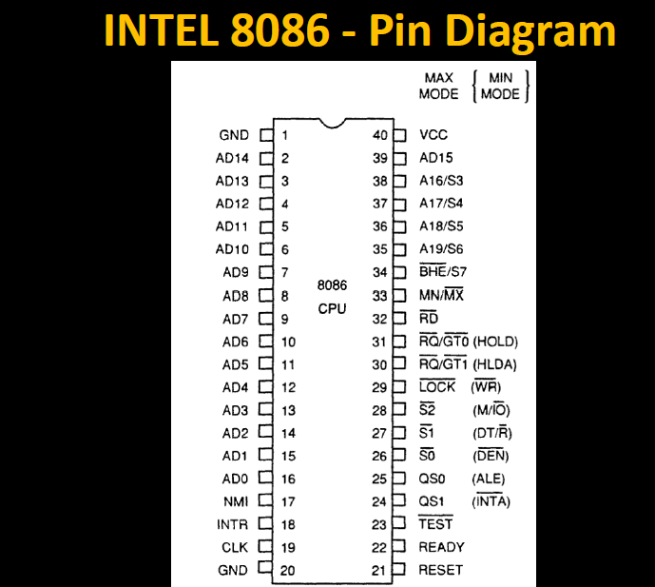
Pin Diagram of 8086

Slide 6
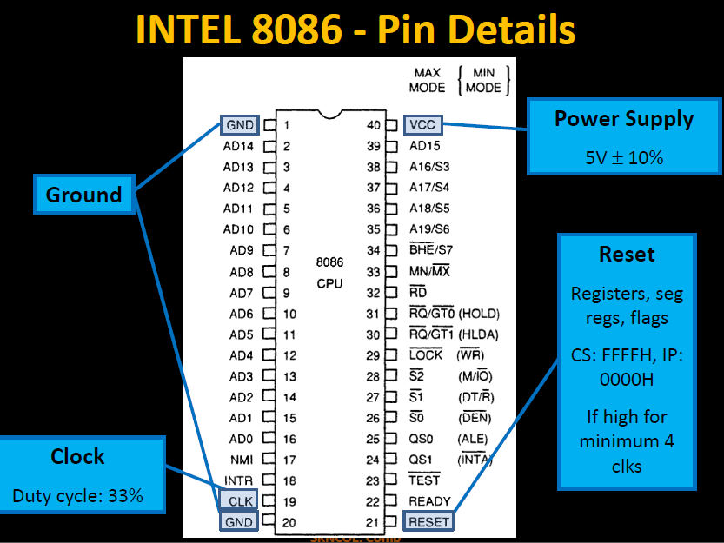

Slide 7
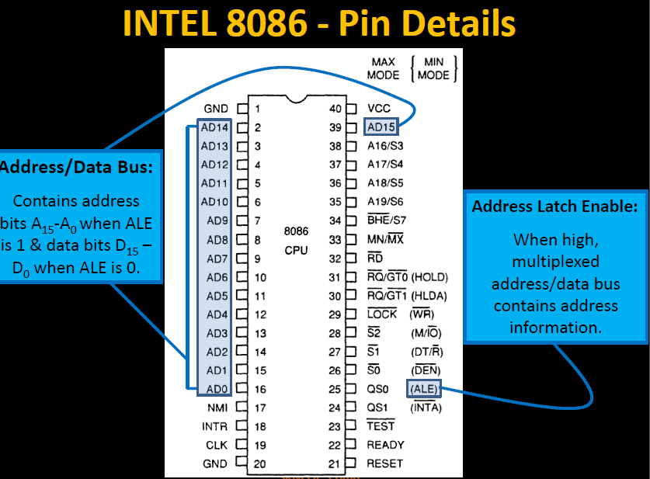

Slide 8
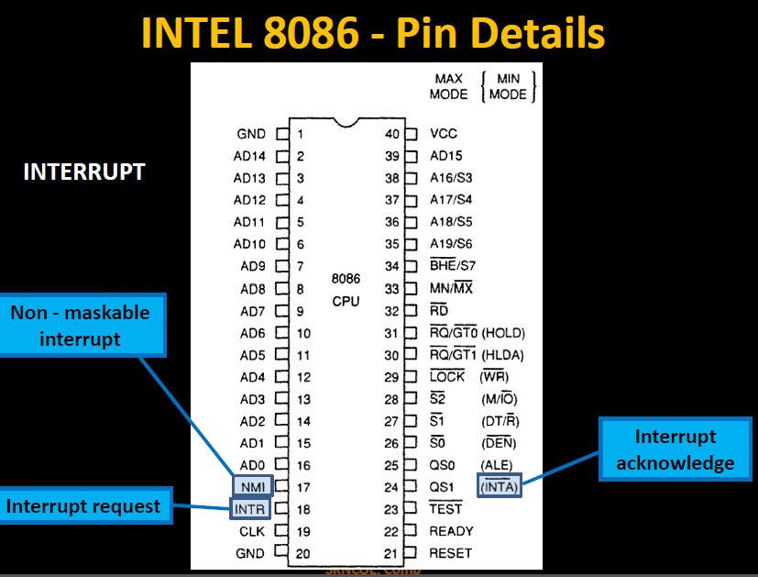

Slide 9
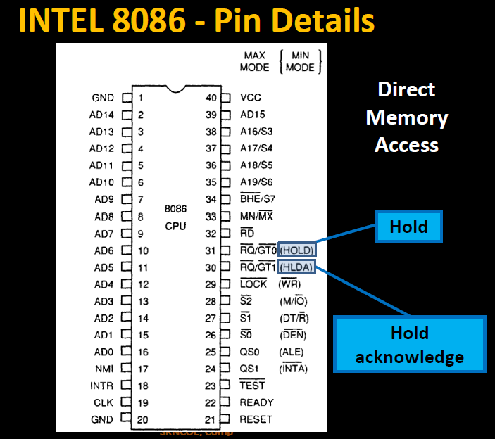

Slide 10
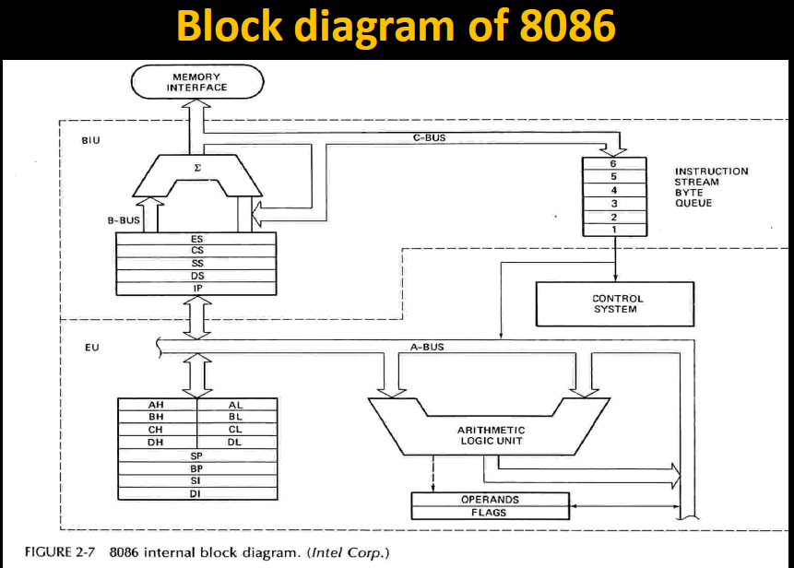

Slide 11
Internal Architecture of 8086
• 8086 has two blocks BIU and EU.
• The BIU (Bus Interface unit)performs all bus operations such as instruction fetching, reading and writing operands for memory and calculating the addresses of the memory operands.
• The instruction bytes are transferred to the instruction queue.
• EU executes instructions from the instruction system byte queue.

Slide 12
Internal Architecture of 8086
Both units operate asynchronously to give the 8086 an overlapping instruction fetch and execution mechanism which is called as Pipelining. This results in efficient use of the system bus and system performance.
• BIU contains Instruction queue, Segment registers, Instruction pointer, Address adder.
• EU contains Control circuitry, Instruction decoder, ALU, Pointer and Index register, Flag register.

Slide 13
Internal Architecture of 8086
Bus Interface Unit:
• It provides a full 16 bit bidirectional data bus and 20 bit address bus.
• The bus interface unit is responsible for performing all
external bus operations.
Specifically it has the following functions:
• Instruction fetch, Instruction queuing, Operand fetch and storage, Address relocation and Bus control.
• The BIU uses a mechanism known as an instruction stream queue to implement a pipeline architecture.

Slide 14
Internal Architecture of 8086
• This queue permits prefetch of up to six bytes of instruction code. When ever the queue of the BIU is not full, it has room for at least two more bytes and at the same time the EU is not requesting it to read or write operands from memory, the BIU is free to look ahead in the program by prefetching the next sequential instruction.
• These prefetching instructions are held in its FIFO queue. With its 16 bit data bus, the BIU fetches two instruction bytes in a single memory cycle.
• After a byte is loaded at the input end of the queue, it automatically shifts up through the FIFO to the empty location nearest the output.

Slide 15
Internal Architecture of 8086
• The EU accesses the queue from the output end. It reads one instruction byte after the other from the output of the queue. If the queue is full and the EU is not requesting access to operand in memory.
• These intervals of no bus activity, which may occur between bus cycles are known as Idle state.
• If the BIU is already in the process of fetching an instruction when the EU request it to read or write operands from memory or I/O, the BIU first completes the instruction fetch bus cycle before initiating the operand read / write cycle.

Slide 16
Internal Architecture of 8086
• The BIU also contains a dedicated adder which is used to generate the 20 bit physical address that is output on the address bus.
• For example, the physical address of the next instruction to be fetched is formed by combining the current contents of the code segment CS register and the current contents of the instruction pointer IP register.
• The BIU is also responsible for generating bus control signals such as those for memory read or write and I/O read or write.

Slide 17
Internal Architecture of 8086
• EXECUTION UNIT : The Execution unit is responsible for decoding and executing all instructions.
• The EU extracts instructions from the top of the queue in the BIU, decodes them, generates operands if necessary, passes them to the BIU and requests it to perform the read or write byte cycles to memory or I/O and perform the operation specified by the instruction on the operands.
• During the execution of the instruction, the EU tests the status and control flags and updates them based on the results of executing the instruction.

Slide 18
Internal Architecture of 8086
• If the queue is empty, the EU waits for the next instruction byte to be fetched and shifted to top of the queue.
• When the EU executes a branch or jump instruction, it transfers control to a location corresponding to another set of sequential instructions.
• Whenever this happens, the BIU automatically resets the queue and then begins to fetch instructions from this new location to refill the queue.

Slide 19
Register organization of 8086
• The 8086 has four groups of the user accessible internal registers. They are the instruction pointer, four data registers, four pointer and index register, four segment registers.
• The 8086 has a total of fourteen 16-bit registers including a 16 bit register called the status register, with 9 of bits implemented for status and control flags.

Slide 20
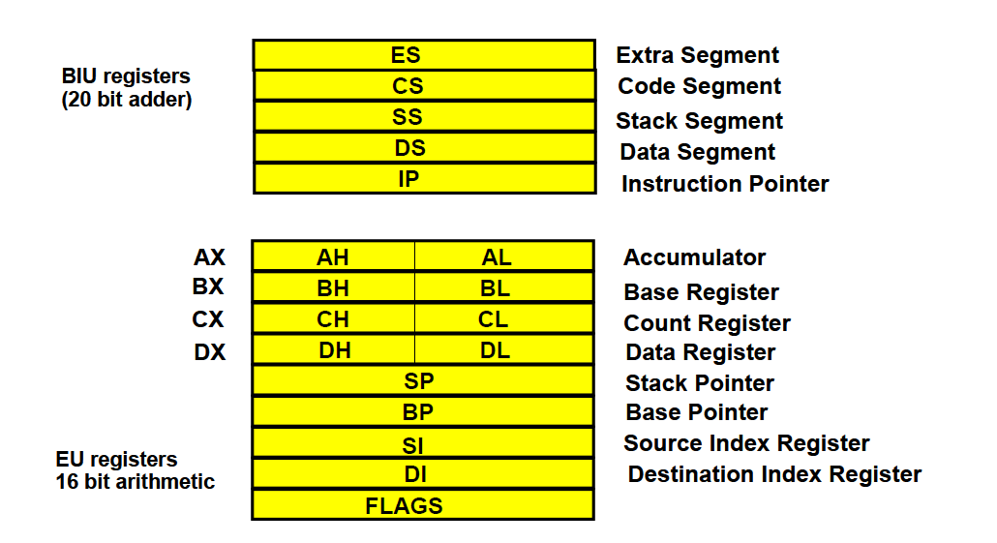

Slide 21
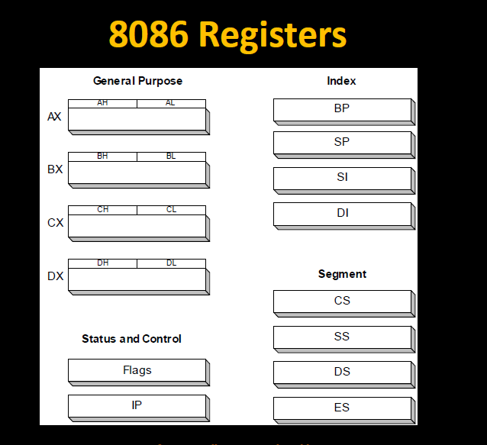

Slide 22
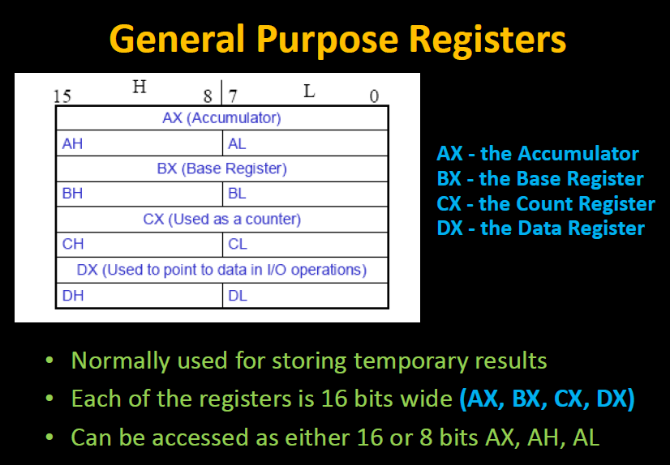

Slide 23
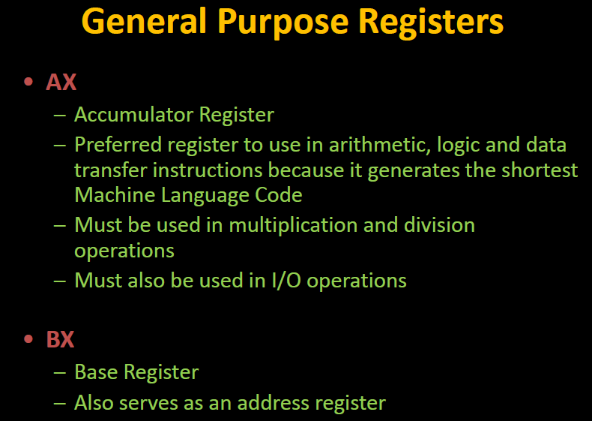

Slide 24
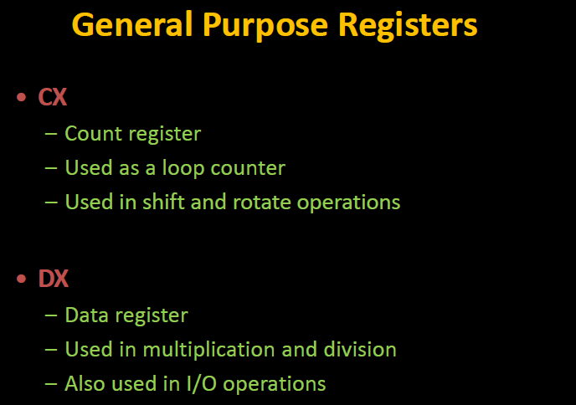

Slide 25
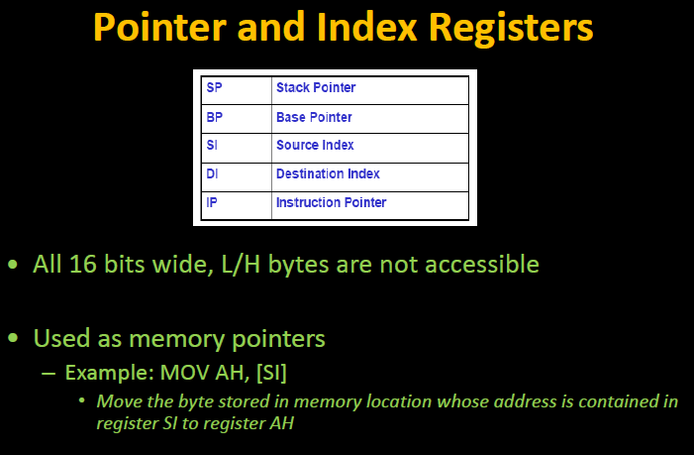

Slide 26
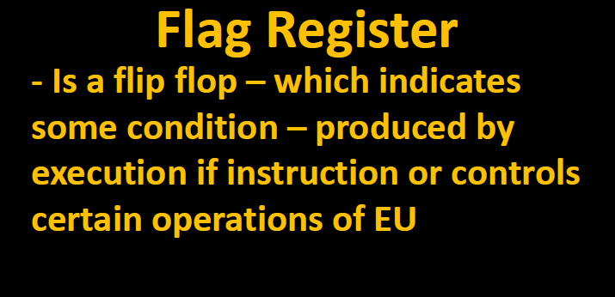

Slide 27
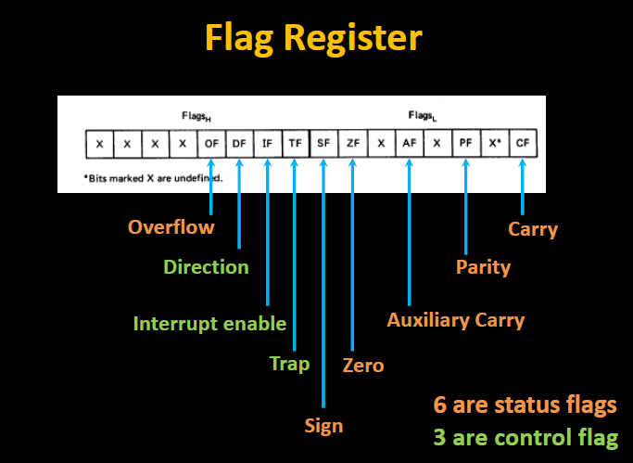

Slide 28
• Flags is a 16-bit register containing 9 one bit flags.
SF- Sign Flag: This flag is set, when the result of any computation is negative. For signed computations the sign flag equals the MSB of the result.
ZF- Zero Flag: This flag is set, if the result of the computation or comparison performed by the previous instruction is zero.
PF- Parity Flag: This flag is set to 1, if the lower byte of the result contains even number of 1’s.
CF- Carry Flag: This flag is set, when there is a carry out of MSB in case of addition or a borrow in case of subtraction.
AF-Auxilary Carry Flag: This is set, if there is a carry from the lowest nibble, i.e, bit three during addition, or borrow for the lowest nibble, i.e, bit three, during subtraction.

Slide 29
Flag Register Continued…
OF- Over flow Flag: This flag is set, if an overflow occurs, i.e, if the result of a signed operation is large enough to accommodate in a destination register. The result is of more than 7-bits in size in case of 8-bit signed operation then the overflow will be set.
TF- Trap Flag: If this flag is set, the processor enters the single step execution mode. The processor executes the current instruction and the control is transferred to the Trap interrupt service routine.
IF- Interrupt Flag: If this flag is set, the maskable interrupts are recognized by the CPU, otherwise they are ignored.
D- Direction Flag: This is used by string manipulation instructions. If this flag bit is ‘0’, the string is processed beginning from the lowest address to the highest address, i.e., auto incrementing mode. Otherwise, the string is processed from the highest address towards the lowest address, i.e., auto decrementing mode.

Slide 30
Programming model of the 8086
The programming model of the 8086 is considered to be program visible because its registers are used during application programming and are specified by the instructions. Figure below illustrates the programming model of 8086 microprocessor.
Some registers are general-purpose or multipurpose registers, while some have special purposes

Slide 31
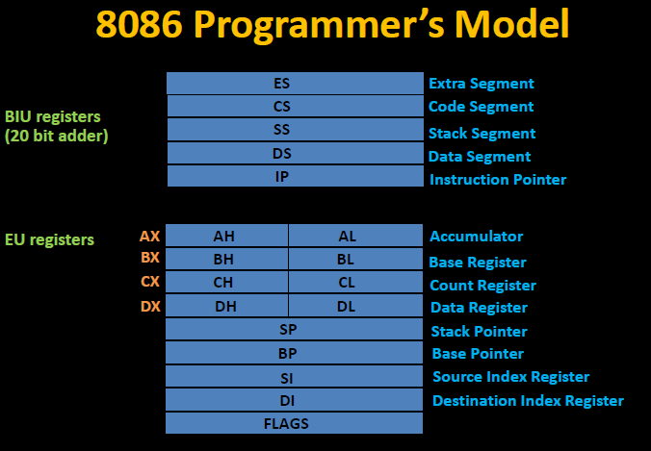

Slide 32
Segment registers
The four segment registers are CS, DS, ES and SS—standing for code segment register, data segment register, extra segment register and stack segment register respectively.
When a particular memory is being read or written into, the corresponding memory address is determined by the content of one of these four segment registers in conjunction with their offset addresses.
The contents of these registers can be changed so that the program may jump from one active code segment to another one.
The use of these segment registers will be more apparent in memory segmentation schemes.

Slide 33
Segment registers
Most of the registers contain data/instruction offsets within 64 KB memory segment.
There are four different 64 KB segments for instructions, stack, data and extra data.
To specify where in 1 MB of processor memory these 4 segments are located the processor uses four segment registers:

Slide 34
Segment registers
Code segment (CS) is a 16-bit register containing address of 64 KB segment with processor instructions.
The processor uses CS segment for all accesses to instructions referenced by instruction pointer (IP) register.
CS register cannot be changed directly. The CS register is automatically updated during far jump, or call and return instructions

Slide 35
Segment registers
Stack segment (SS) is a 16-bit register containing address of 64KB segment with program stack.
By default, the processor assumes that all data referenced by the stack pointer (SP) and base pointer (BP) registers is located in the stack segment.
SS register can be changed directly using POP instruction

Slide 36
Segment registers
Data segment (DS) is a 16-bit register containing address of 64KB segment with program data.
By default, the processor assumes that all data referenced by general registers (AX, BX, CX, DX) and index register (SI, DI) is located in the data segment.
DS register can be changed directly using POP.

Slide 37
Segmentation
Segmentation is the process in which the main memory of the computer is divided into different segments and each segment has its own base address.
It is basically used to enhance the speed of execution of the computer system, so that processor is able to fetch and execute the data from the memory easily and fast.

Slide 38
Need for Segmentation –
The Bus Interface Unit (BIU) contains four 16 bit special purpose registers (mentioned below) called as Segment Registers.
Code segment register (CS): is used for addressing memory location in the code segment of the memory, where the executable program is stored.
Data segment register (DS): points to the data segment of the memory where the data is stored.
Extra Segment Register (ES): also refers to a segment in the memory which is another data segment in the memory.
Stack Segment Register (SS): is used for addressing stack segment of the memory. The stack segment is that segment of memory which is used to store stack data.

Slide 39
Need for Segmentation –
The number of address lines in 8086 is 20, 8086 BIU will send 20bit address, so as to access one of the 1MB memory locations.
The four segment registers actually contain the upper 16 bits of the starting addresses of the four memory segments of 64 KB each with which the 8086 is working at that instant of time.
A segment is a logical unit of memory that may be up to 64 kilobytes long. Each segment is made up of contiguous memory locations. It is independent, separately addressable unit. Starting address will always be changing. It will not be fixed.
Note that the 8086 does not work the whole 1MB memory at any given time. However it works only with four 64KB segments within the whole 1MB memory.

Slide 40
Advantages of the Segmentation
The main advantages of segmentation are as follows:
It provides a powerful memory management mechanism.
Data related or stack related operations can be performed in different segments.
Code related operation can be done in separate code segments.
It allows to processes to easily share data.
It allows to extend the address ability of the processor, i.e. segmentation allows the use of 16 bit registers to give an addressing capability of 1 Megabytes. Without segmentation, it would require 20 bit registers.
It is possible to enhance the memory size of code data or stack segments beyond 64 KB by allotting more than one segment for each area.

Slide 41
Memory Organization
8086, via its 20-bit address bus, can address 2²⁰ = 1,048,576 or 1 MB of different memory locations.
The memory map of 8086 is shown in Fig. 12.1, where the whole memory space starting from 00000 H to FFFFF H is divided into 16 blocks—each one consisting of 64 KB.
This division is arbitrary but at the same time a convenient one—because the most significant hex digit increases by 1 with each additional block.
The lower and upper ends of the memory map are shown separately—earmarking some spaces as reserved and some as ‘dedicated’.
The reserved locations are meant for future hardware and software needs while the dedicated locations are used for processing of specific system interrupts and reset functions.

Slide 42
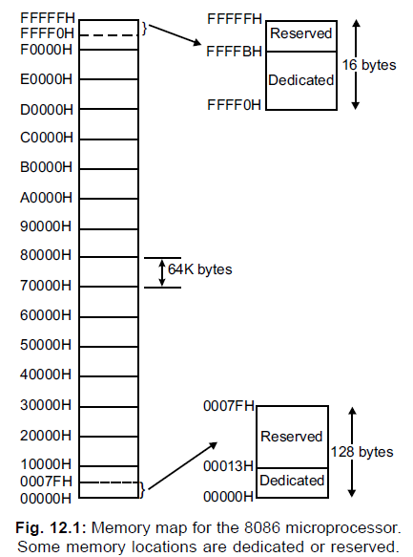
Memory Organization

Slide 43
Q. Describe memory segmentation scheme of 8086. What is meant by currently active segments?
1 MB memory of 8086 is partitioned into 16 segments—each segment is of 64 KB length. Out of these 16 segments, only 4 segments can be active at any given instant of time— these are code segment, stack segment, data segment and extra segment
The four memory segments that the CPU works with at any time are called currently active segments.
Corresponding to these four segments, the registers used are Code Segment Register (CS), Data Segment Register (DS), Stack Segment Register (SS) and Extra Segment Register (ES) respectively.
Each of these four registers is 16-bits wide and user accessible—i.e., their contents can be changed by software.

Slide 44
Memory Organization
The code segment contains the instruction codes of a program, while data, variable and constants are held in data segment.
The stack segment is used to store interrupt and subroutine return addresses.
The extra segment contains the destination of data for certain string instructions. Thus 64 KB are available for program storage (in CS) as well as for stack (in SS) while 128 KB of space can be utilised for data storage (in DS and ES)

Slide 45
Q. Describe how the 20-bit physical address is generated?
The 20-bit physical (real) address is generated by combining the offset (residing in IP, BP, SP, BX, SI or DI) and the content of one of the segment registers CS, DS, ES or SS.
The process of combination is as follows:
The content of the segment register is internally appended with 0 H (0000 H) on its right most end to form a 20-bit memory address—this 20-bit address points to the start of the segment.
The offset is then added to the above to get the physical address.
Fig. 12.3 shows pictorially the actual process of generating a 20-bit physical address.

Slide 46
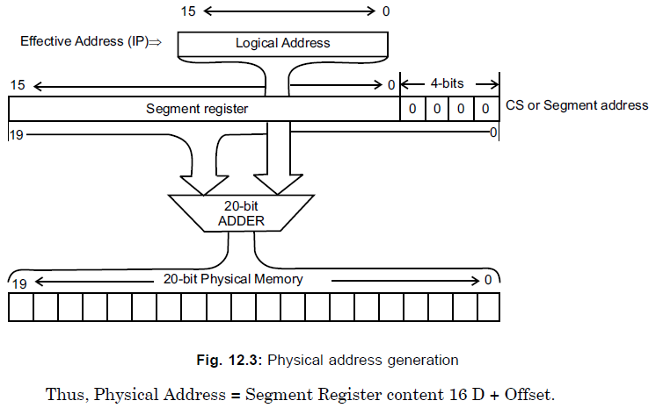

Slide 47
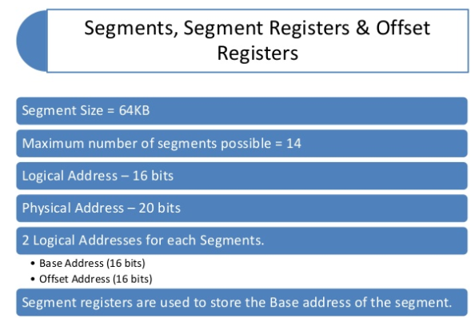

Slide 48
Q. Discuss logical address, base segment address and physical address.
The logical address, also goes by the name of effective address or offset address (also known as offset), is contained in the 16-bit IP, BP, SP, BX, SI or DI.
The 16-bit content of one of the four segment registers (CS, DS, ES, SS) is known as the base segment address.
Offset and base segment addresses are combined to form a 20-bit physical address (also called real address) that is used to access the memory.
This 20-bit physical address is put on the address bus (AD19 – AD0) by the BIU.

Slide 49
Describe memory segmentation scheme of 8086. What is meant by currently active segments?
1 MB memory of 8086 is partitioned into 16 segments—each segment is of 64 KB length.
Out of these 16 segments, only 4 segments can be active at any given instant of time— these are code segment, stack segment, data segment and extra segment.
The four memory segments that the CPU works with at any time are called currently active segments.
Corresponding to these four segments, the registers used are Code Segment Register (CS), Data Segment Register (DS), Stack Segment Register (SS) and Extra Segment Register (ES) respectively.
Each of these four registers is 16-bits wide and user accessible—i.e., their contents can be changed by software.

Slide 50
The code segment contains the instruction codes of a program, while data, variables and constants are held in data segment.
The stack segment is used to store interrupt and subroutine return addresses.
The extra segment contains the destination of data for certain string instructions.
Thus 64 KB are available for program storage (in CS) as well as for stack (in SS) while 128 KB of space can be utilised for data storage (in DS and ES).

Slide 51
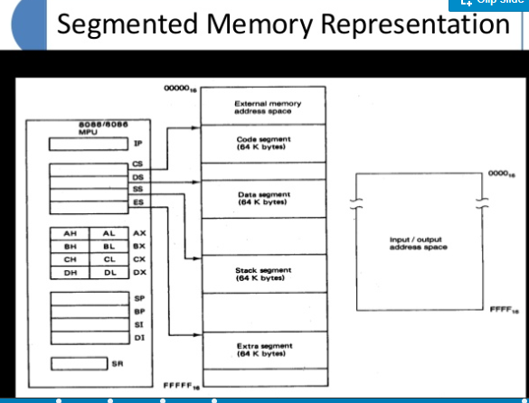

Slide 52
Mention the maximum size of memory that can be active for 8086.
The maximum size of active memory for 8086 is 256 KB. The break-up being
64 KB for program
64 KB for stack and
128 MB for data.(DS+ES)

Slide 53
Programming model of the 8086
The programming model of the 8086 is considered to be program visible because its registers are used during application programming and are specified by the instructions.
Figure below illustrates the programming model of 8086 microprocessor.
Some registers are general-purpose or multipurpose registers, while some have special purposes

Slide 55
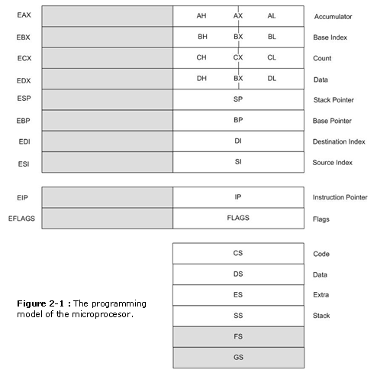
Programming Model
Figure 2-1 illustrates the programming model of the 8086 through the Pentium II micro­processor.

Slide 56
Programming Model
The programming model contains 8-, 16-, and 32-bit registers. The 8-bit registers are AH, AL, BH, BL, CH, CL, DH, and DL and are referred to when an instruction is formed using these two-letter designations.
The 16-bit registers are AX, BX, CX, DX, SP, BP, DI, SI, IP, FLAGS, CS, DS, ES, SS The extended 32-bit registers are EAX, EBX, ECX, EDX, ESP, EBP, EDI, ESI, EIP, and EFLAGS. These 32-bit extended registers, and 16-bit registers ES and GS are available only in the 80386 and above.
Some registers are general-purpose or multipurpose registers, while some have special purposes. The multipurpose registers include EAX, EBX, ECX, EDX, EBP, EDI, and ESI.
These registers hold various data sizes (bytes, words, or doublewords) and are used for almost any purpose, as dictated by a program.

Slide 57
Real Mode Memory Addressing
The 80286 and above operate in either the real or protected mode.
Only the 8086 and 8088 op­erate exclusively in the real mode.
Real mode operation allows the microprocessor to address only the first 1M byte of memory space-even if it is the Pentium II microprocessor.
Note that the first 1 M byte of memory is called either the real memory or conventional memory system.
The DOS operating system requires the microprocessor to operate in the real mode.
Real mode oper­ation allows application software written for the 8086/8088, which contain only 1 M byte of memory, to function in the 80286 and above without changing the software.
The upward com­patibility of software is partially responsible for the continuing success of the Intel family of mi­croprocessors.
In all cases, each of these microprocessors begins operation in the real mode by default whenever power is applied or the microprocessor is reset.

Slide 58
Segments And Offsets
A combination of a segment address and an offset address, access a memory location in the real mode.
All real mode memory addresses must consist of a segment address plus an offset address.
The segment address, located within one of the segment registers, defines the beginning address of any 64K-byte memory segment.
The offset address selects any location within the 64K byte memory segment.
Segments in the real mode always have a length of 64K bytes.
Figure 2-3 shows how the segment plus offset addressing scheme selects a memory location.
This illustra­tion shows a memory segment that begins at location 1 0000H and ends at location 1 FFFEH 64K bytes in length.
It also shows how an offset address, sometimes called a displacement, of F000H selects location 1F000H in the memory system.
Note that the offset or displacement is the distance above the start of the segment, as shown in Figure 2-3.

Slide 59
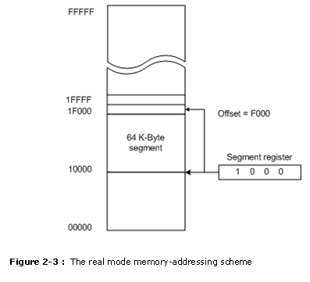

Slide 60
Segments and Offsets
The segment register in Figure 2-3 contains a 1000H, yet it addresses a starting segment at location 10000H.
In the real mode, each segment register is internally appended with a 0H on its rightmost end. This forms a 20-bit memory address, allowing it to access the start of a segment.
The microprocessor must generate a 20-bit memory address to access a location within the first 1 M of memory.
For example, when a segment register contains a 1200H, it addresses a 64K-byte memory segment beginning at location 12000H.
Likewise, if a segment register contains a 1201H, it addresses a memory segment beginning at location 12010H.

Slide 61
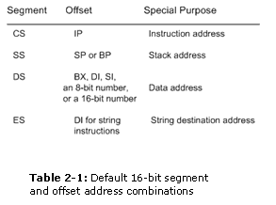

Slide 62
Introduction to Protected Mode Memory Addressing
Protected mode memory addressing (80286 and above) allows access to data and programs located above the first 1M byte of memory, as well as within the first 1M byte of memory.
Addressing this extended section of the memory system requires a change to the segment plus an offset addressing scheme used with real mode memory addressing.
When data and programs are addressed in extended memory, the offset address is still used to access information located within the memory segment.
One difference is that the segment address, is no longer present in the protected mode.
In place of the segment address, the segment register contains a selector that selects a descriptor from a descriptor table.

Slide 63
Introduction to Protected Mode Memory Addressing
The descriptor describes the memory segment’s location, length, and access rights.
Because the segment register and offset address still access memory, protected mode instructions are iden­tical to real mode instructions.
In fact, most programs written to function in the real mode will function without change in the protected mode.
The difference between modes is in the way that the segment register is interpreted by the microprocessor to access the memory segment.
An­other difference, in the 80386 and above, is that the offset address can be a 32-bit number instead of a 16-bit number in the protected mode. A 32-bit offset address allows the microprocessor to access data within a segment that can be up to 4G bytes in length.

Slide 64
Selectors And Descriptors
The selector, located in the segment register, selects one of 8192 descriptors from one of two ta­bles of descriptors.
The descriptor describes the location, length, and access rights of the seg­ment of memory.
Indirectly, the segment register still selects a memory segment, but not directly as in the real mode. For example, in the real mode, if CS = 0008H, the code segment begins at lo­cation 00080H.
In the protected mode, this segment number can address any memory location in the entire system for the code segment.

Slide 65
Selectors And Descriptors
There are two descriptor tables used with the segment registers: one contains global de­scriptors and the other contains local descriptors.
The global descriptors contain segment defini­tions that apply to all programs, while the local descriptors are usually unique to an application.
A global descriptor is a system descriptor and local descriptor is an application descriptor.
Each descriptor table contains 8192 descriptors, so a total of 16,384 total descriptors are available to an application at any time.
Because the descriptor describes a memory segment, this allows up to 16,384 memory segments to be described for each application.

Slide 66
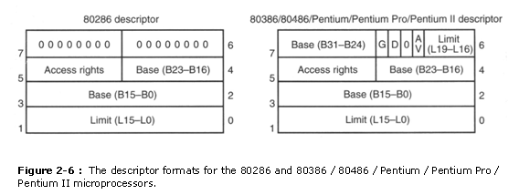
Figure 2-6 shows the format of a descriptor for the 80286 through the Pentium II.
Note that each descriptor is 8 bytes in length, so the global and local descriptor tables are each a max­imum of 64K bytes in length. Descriptors for the 80286 and the 80386 through the Pentium II differ slightly,

Slide 67
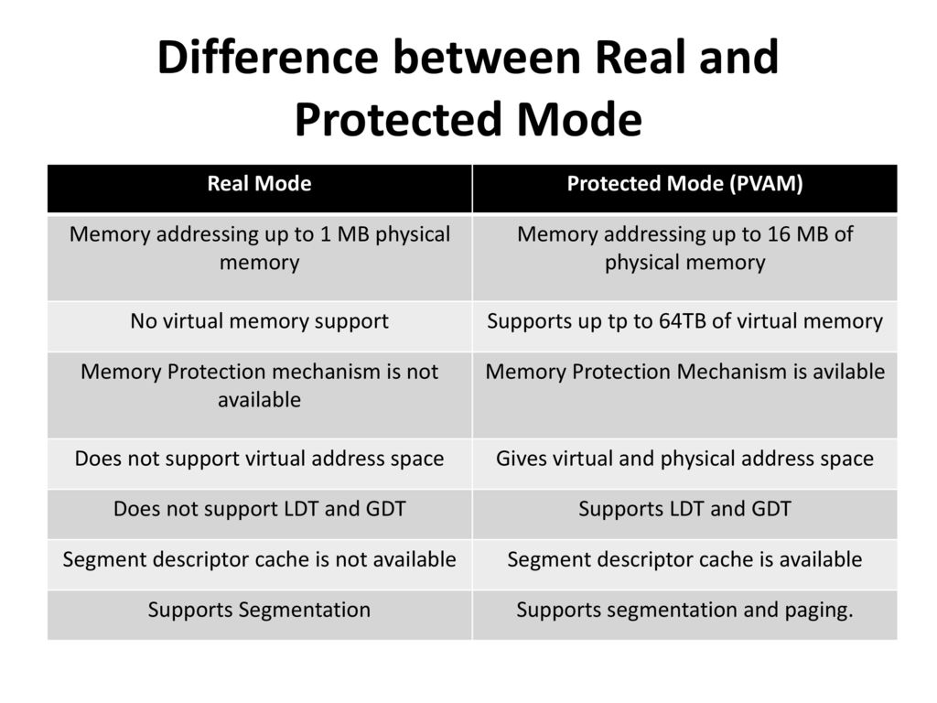

Slide 68
Paging
A computer can address more memory than the amount physically installed on the system.
This extra memory is actually called virtual memory and it is a section of a hard disk that's set up to emulate the computer's RAM.
Paging technique plays an important role in implementing virtual memory.
Paging is a memory management technique in which process address space is broken into blocks of the same size called pages.
The size of the process is measured in the number of pages.
Similarly, main memory is divided into small fixed-sized blocks of (physical) memory called frames and the size of a frame is kept the same as that of a page to have optimum utilization of the main memory.

Slide 69
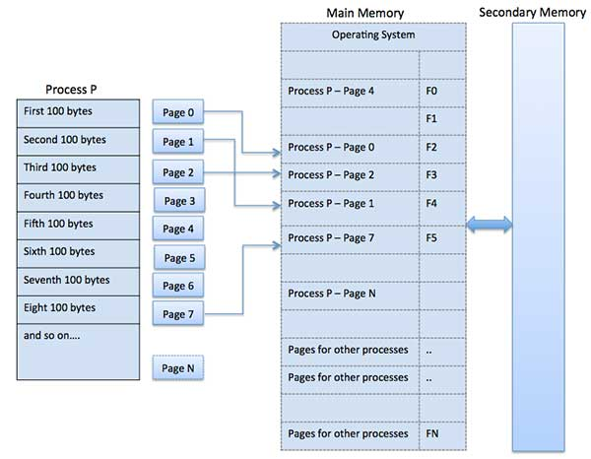

Slide 70
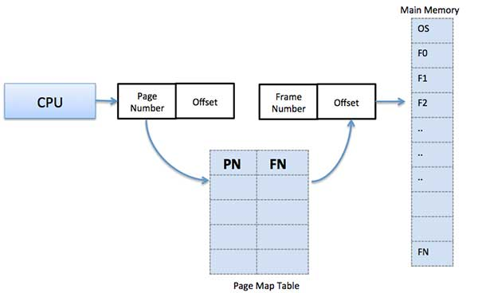
Address Translation
Page address is called logical address and represented by page number and the offset.
Logical Address = Page number + page offset Frame address is called physical address and represented by a frame number and the offset.
Physical Address = Frame number + offset A data structure called page map table is used to keep track of the relation between a page of a process to a frame in physical memory.

Slide 71
Paging…
When the system allocates a frame to any page, it translates this logical address into a physical address and create entry into the page table to be used throughout execution of the program.
When a process is to be executed, its corresponding pages are loaded into any available memory frames.
Suppose you have a program of 8Kb but your memory can accommodate only 5Kb at a given point in time, then the paging concept will come into picture.
When a computer runs out of RAM, the operating system (OS) will move idle or unwanted pages of memory to secondary memory to free up RAM for other processes and brings them back when needed by the program.
This process continues during the whole execution of the program where the OS keeps removing idle pages from the main memory and write them onto the secondary memory and bring them back when required by the program.

Slide 72
Advantages and Disadvantages of Paging
Here is a list of advantages and disadvantages of paging −
Paging reduces external fragmentation.
Paging is simple to implement and assumed as an efficient memory management technique.
Due to equal size of the pages and frames, swapping becomes very easy.
Page table requires extra memory space, so may not be good for a system having small RAM.

Slide 73
Addressing mode
An addressing mode refers to how you are addressing a given memory location
These are
1. Data addressing modes,
2. Memory addressing modes, and
3. Stack addressing.

Slide 74
Data-addressing modes
The data-addressing modes include
1. register,
2. immediate,
3. direct,
4. register indirect

Slide 75
Program memory-addressing modes
The program memory-addressing modes include
1. program relative,
2. direct, and
3. indirect.
The operation of the stack memory is explained so that the PUSH and POP instructions are understood.

Slide 76
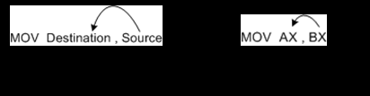
3. Data-Addressing Modes
Because the MOV instruction is a common and flexible instruction, it provides a basis for the ex­planation of the data-addressing modes.
From Figure below, The source is to the right and the destination is to the left, next to the op­code MOV.
An opcode, or operation code, tells the microprocessor which operation to perform.
In Figure 3-1, the MOV AX,BX instruction transfers the word contents of the source reg­ister (BX) into the destination register (AX). The source never changes, but the destination usu­ally changes.¹ It is essential to remember that a MOV instruction always copies the source data and into the destination. The MOV never actually picks up the data and moves it.

Slide 77
3.1 Register addressing
Register addressing is the most common form of data addressing.
The microprocessor contains the following 8-bit registers used with register addressing: AH, AL, BH, BL, CH, CL, DH, and DL. Also present are the fol­lowing 16-bit registers: AX, BX, CX, DX, SP, BP, SI, and DI.
In the 80386 and above, the ex­tended 32-bit registers are EAX, EBX, ECX, EDX, ESP, EBP, EDI, and ESI.
It is important for instructions to use registers that are the same size

Slide 78
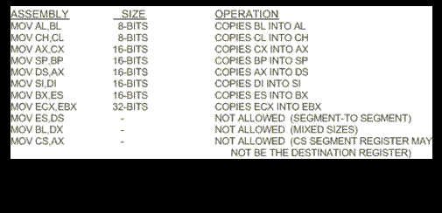
3.1 Register addressing
Table 3-1 shows some variations of register move instructions. A segment-to-segment register MOV instruction is not allowed.

Slide 79
3.2. Immediate Addressing
It is termed as immediate because 8-bit data is transferred immediately to the accumulator (destination operand).
The data is provided in the instruction
Let's begin with an example.
MOV A, #6A H
In general, we can write,
MOV A, #data

Slide 80
Direct Data Addressing
This is another way of addressing an operand. Here, the address of the data (source data) is given as an operand.
Let’s take an example.
MOV A, 04H
The register bank#0 (4th register) has the address 04H.
When the MOV instruction is executed, the data stored in register 04H is moved to the accumulator.
As the register 04H holds the data 1FH, 1FH is moved to the accumulator.

Slide 81
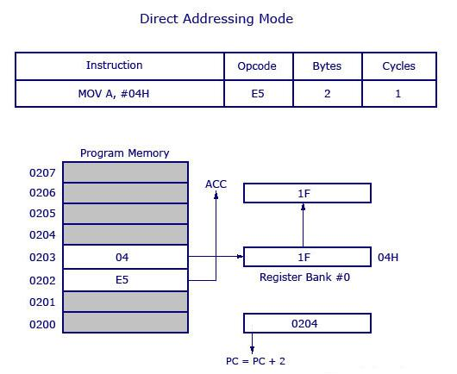

Slide 82
Register Indirect Addressing Mode
In this addressing mode, the address of the data is stored in the register as operand.
MOV A, @R0 Here the value inside R0 is considered as an address, which holds the data to be transferred to the accumulator.
Example: If R0 has the value 20H, and data 2FH is stored at the address 20H, then the value 2FH will get transferred to the accumulator after executing this instruction.

Slide 83
STACK MEMORY-ADDRESSING MODES
The stack plays an important role in all microprocessors.
It holds data temporarily and stores re­turn addresses for procedures.
The stack memory is a LIFO (last-in, first-out) memory, which describes the way that data are stored and removed from the stack.
Data are placed onto the stack with a PUSH instruction and removed with a POP instruction.
The stack memory is maintained by two registers: the stack pointer (SP) and the stack segment register (SS).
The SP register always points to an area of memory located within the stack segment.
The SP register adds to SS + OH to form the stack memory address in the real mode. In protected mode operation, the SS register holds a selector that accesses a descriptor for the base address of the stack segment.

Slide 84
Thank You

